Slide 1
Optimal MBTA
Bus Stops Selection
Hayden Ratliff (hratliff@mit.edu), Maxime Wolf (maximew@mit.edu)
December 12, 2023

Slide 2
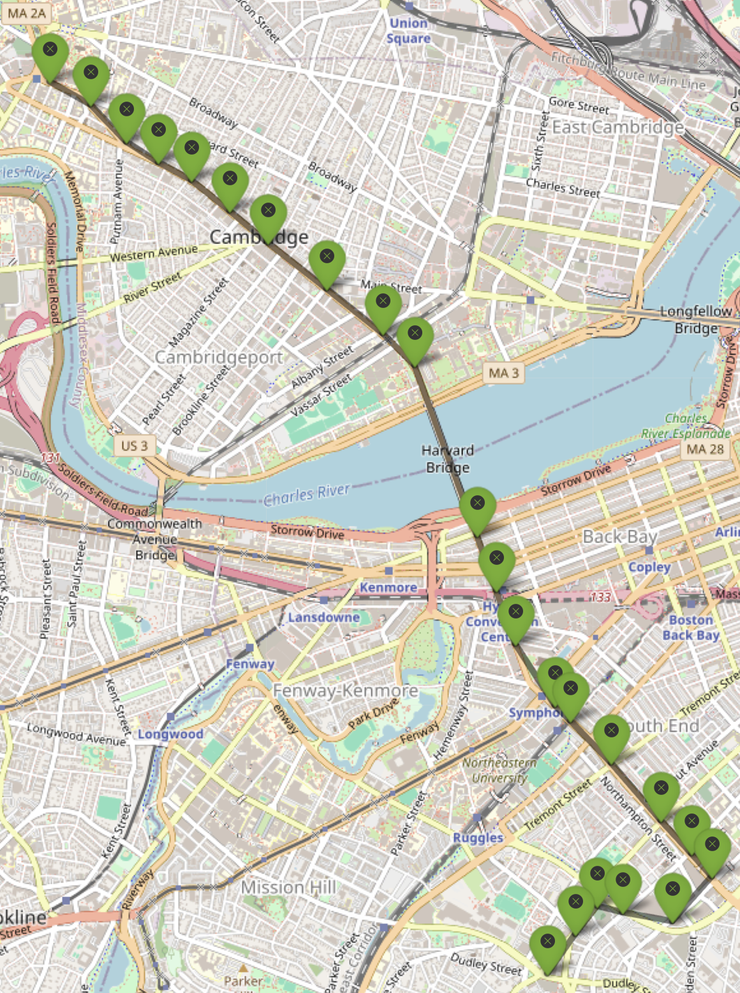
Motivation & Introduction
Boston has lots of bus routes…
Can we improve the efficiency of bus routes and reduce CO2 emissions while maintaining ridership by selecting a subset of stops for each route?
MBTA’s Bus Route 1

Slide 3
Datasets: MBTA Bus Ridership and Stop Locations
Example: Route 1
Stop name | Stop ID | X | Y | Average load (after the stop) | Average on | Average off | Route | Time period
Mass Ave station | 1188 | -71.08 | 42.34 | 12.6 | 1.575 | 0.98 | 1 | VERY EARLY AM
Mass Ave station | 1188 | -71.08 | 42.34 | 13.4 | 3.50 | 1.79 | 1 | EARLY AM
…
Hancock St station | 106 | -71.11 | 42.37 | 2.6 | 0.02 | 0.22 | 1 | NIGHT
…
…
24 * 11 rows: 11 time periods for each of the 24 stops

Slide 4
Approach
We want to find a trade-off between profit maximization and CO2 emissions reduction by solving the following MIO (non-linear) problem:
Max 𝝺 ⨉ Profit - (1-𝝺) ⨉ CO2
Function of the number of people going on at the selected stops
Function of the load and distances between 2 stops, and the number of selected stops
Simple model without time periods:
Bus load conservation
Always selects route endpoints
Solving time = 2 sec.
Complex model with time periods:
11 daily time periods
4 changes in stop selection per day allowed
Solving time = up to 70 min. for some 𝝺

Slide 5
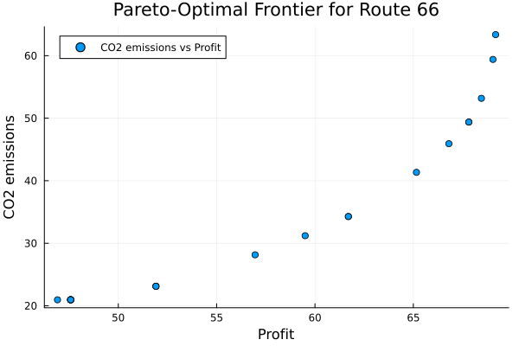
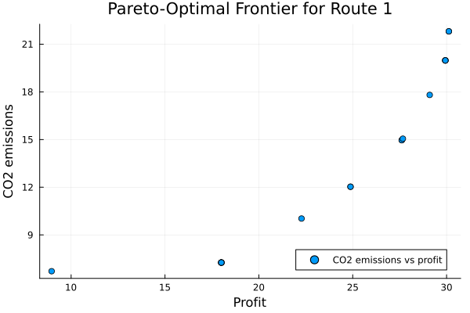
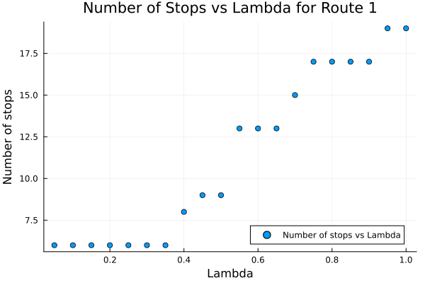
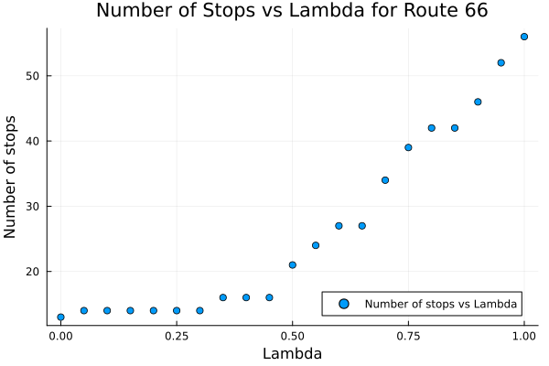
Results: Pareto-Optimal Frontiers and Number of Stops

Slide 6
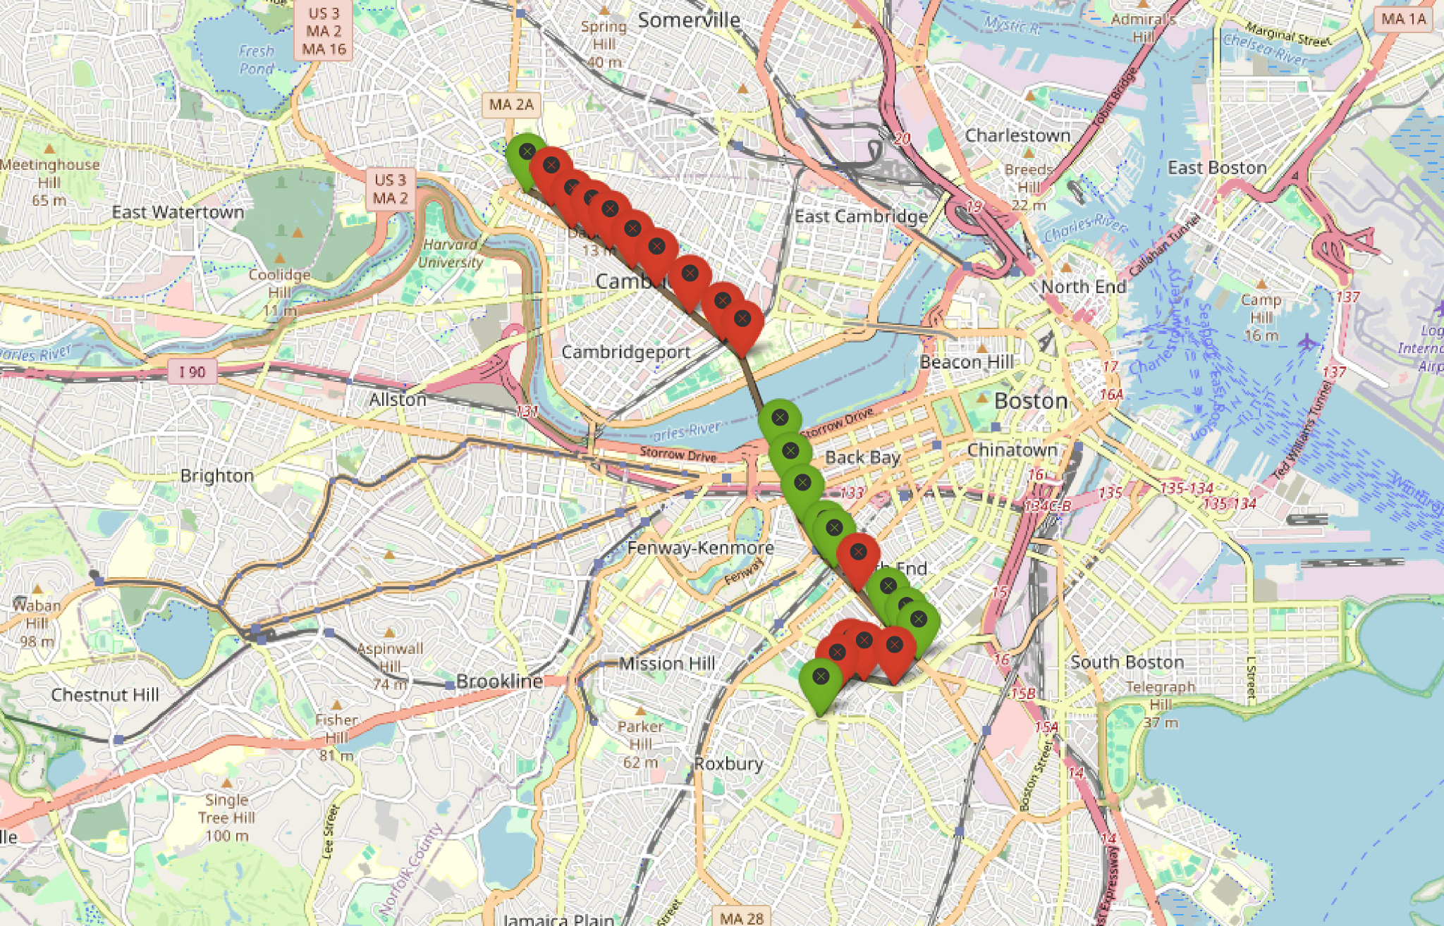
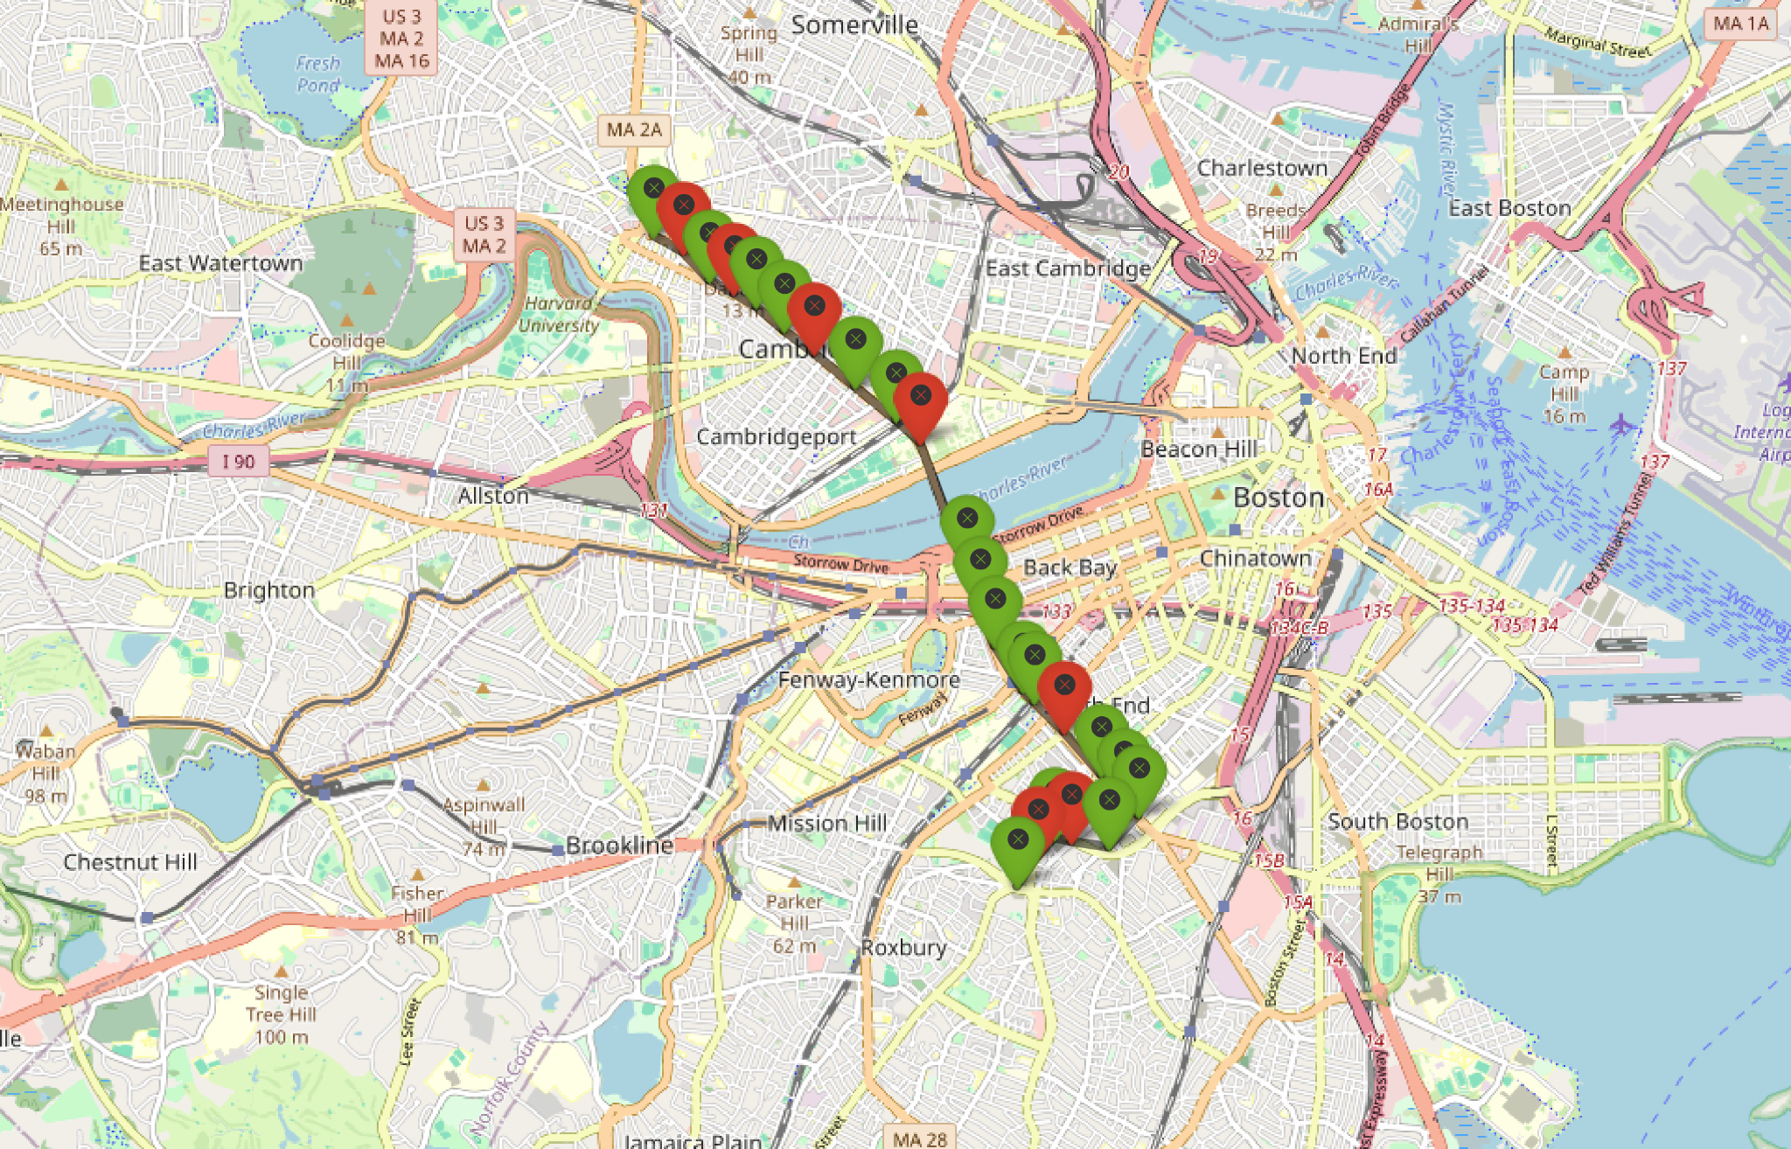
Results: Adding Constraints
Our model formulation is flexible: one can easily add constraints depending on the context
Problem, no stops in Cambridge
Constraint: don’t remove consecutive stops
55.9% CO2 emissions decrease
18.2% profit decrease
28.4% CO2 emissions decrease
11.5% profit decrease

Slide 7

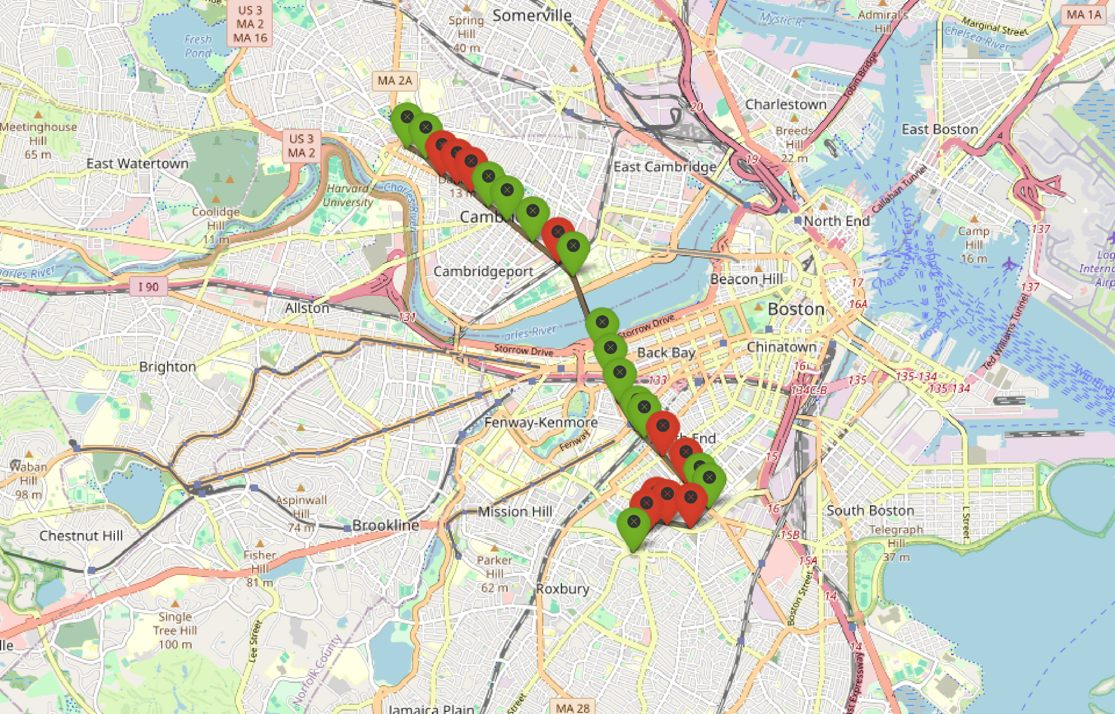
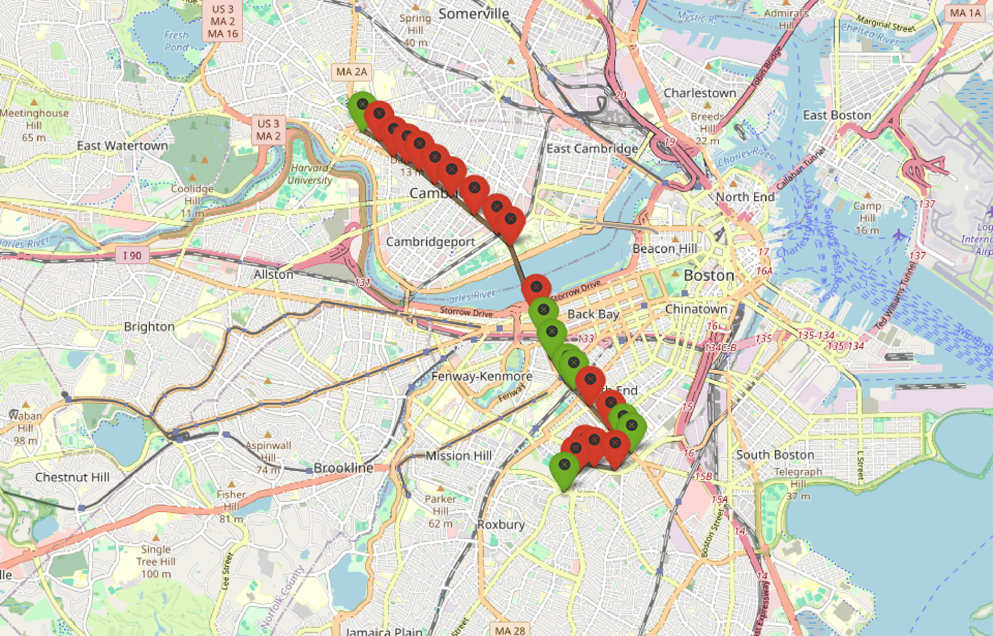
Results: Selection Depending on the Time of the Day
We visualize the solution of our time periods model for route 1 and 𝝺 fixed
Midday
PM Peak
Evening
Night
PM Peak and Evening have been assigned to the same group by our model so the solution is the same
Midday: people are working in Boston
PM Peak / Evening: people are traveling between Cambridge and Boston to go back home
Night: fewer stops because fewer people take the bus

Slide 8



Conclusion: impact and next steps
Effective Trade-Off Achievement: Successfully balanced profit and environmental impact using a weighted approach, exemplifying an innovative method in urban transportation optimization.
High Impact: Demonstrated with Route 1, where selecting 16 strategic stops reduced CO2 emissions by 32% with a minimal revenue loss of only 6%, compared to the baseline scenario of 24 stops.
Next Steps: Aim to expand our model to encompass the entire MBTA bus network, introducing linking constraints across different routes for a more integrated and efficient system-wide optimization.

